Slide 1

District #5680 Conference
Liberal, KS
October 21-23rd, 2022
Part one of three
Presenter Name

Slide 2
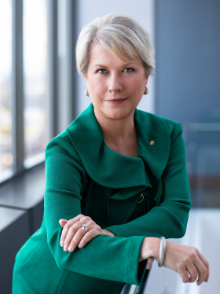
Jennifer Jones
President 2022-23
Rotary Club of Windsor-Roseland
Ontario, Canada
Jennifer Jones is the founder and president of Media Street Productions, an award-winning 27-year-old media company in Windsor, Ontario. She is a member of the Rotary Club of Windsor-Roseland.
Jennifer's talents have strengthened Rotary's reach and impact as she has served in roles including vice president, director, Rotary Foundation trustee, and co-chair of the End Polio Now: Make History Today fundraising campaign.
More about Jennifer Jones @
https://my.rotary.org/en/news-media/office-president/ri-president

Slide 3
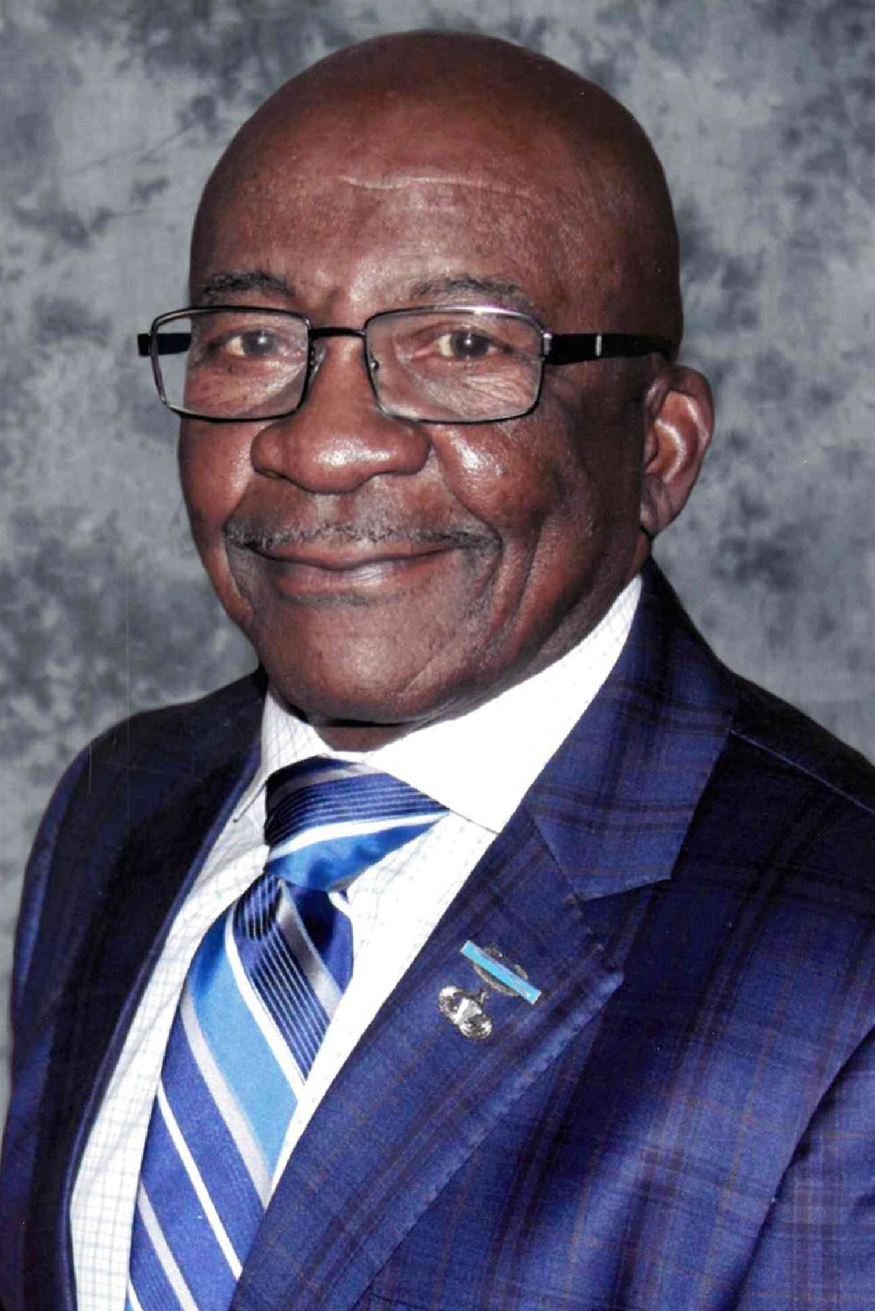
Now, meet our
District Governor
Ivanhoe Love Jr. – Liberal, KS
Retired from the United States Army 1990
28 years of service
Highest enlisted rank possible:
“Command Sergeant Major”
Mr. Love is currently
Trustee on the hospital board at Southwest Medical Center
Chairman of Focus on the Future (an oversight committee of the one cent sales tax)
Chairman of the Northeast Liberal Leadership Group (N.E.L.L.).
Ivanhoe joined the Rotary Club of Liberal in 1992
A Paul Harris fellow second award recipient
Club President 2018-2019
District Governor Elect 21-22
Ivanhoe says that Rotary has become a way of life

Slide 4
District Team #5680
Gloria Homeier
Governor Elect 2023-24
Jeff Horlacher
Governor - Nominee
Kent Erb
Secretary / Treasuer
Arlen Honts
District Trainer

Slide 5
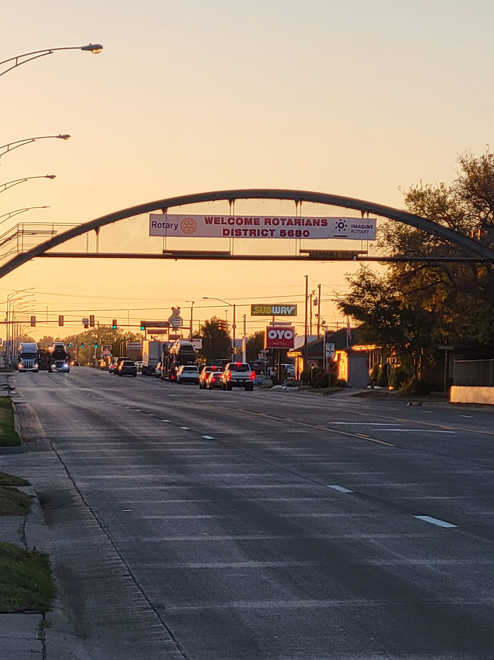
Arriving in Liberal, KS

Slide 6
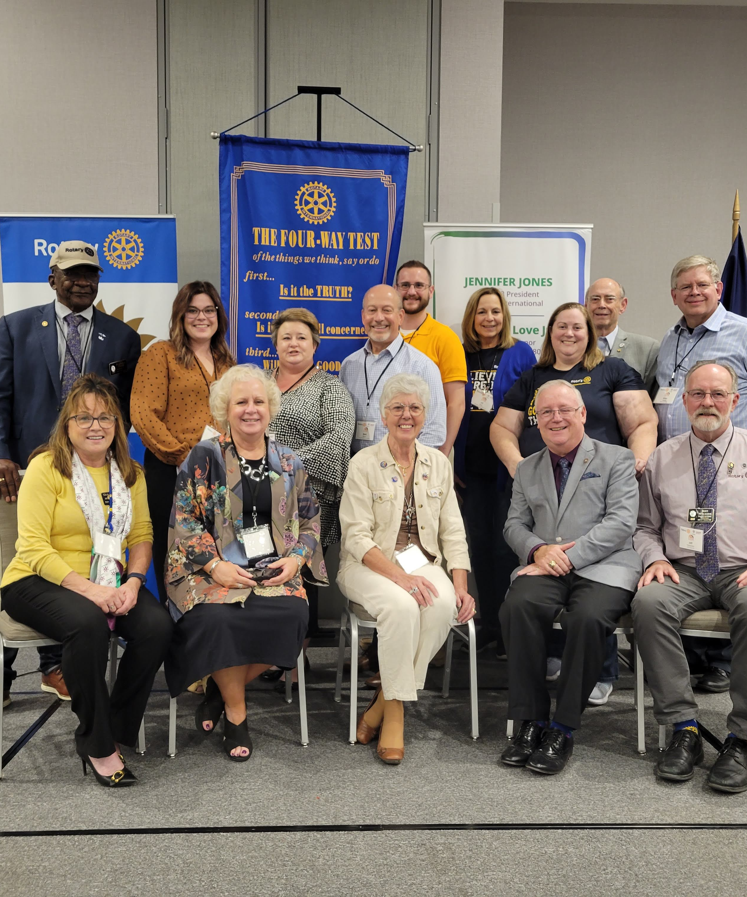
3rd RLI District Training
Ivanhoe Love, Jr. – District Governor
Kayla - Russell
Shasta – Russell
Mark – Wichita
Josh – Colby
Jill – Washington
Leslie – “Old Town” Wichita
“Ed” Thurmond – International Pres. Rep.
Harlan – Wichita – District Trainer
Jeff Horlacher – Colby
Fred Heismeyer – Past District Governor
Criquet – Phillipsburg
Connie - Russell
Gloria Homeier – Gov. Elect - Russell

Slide 7
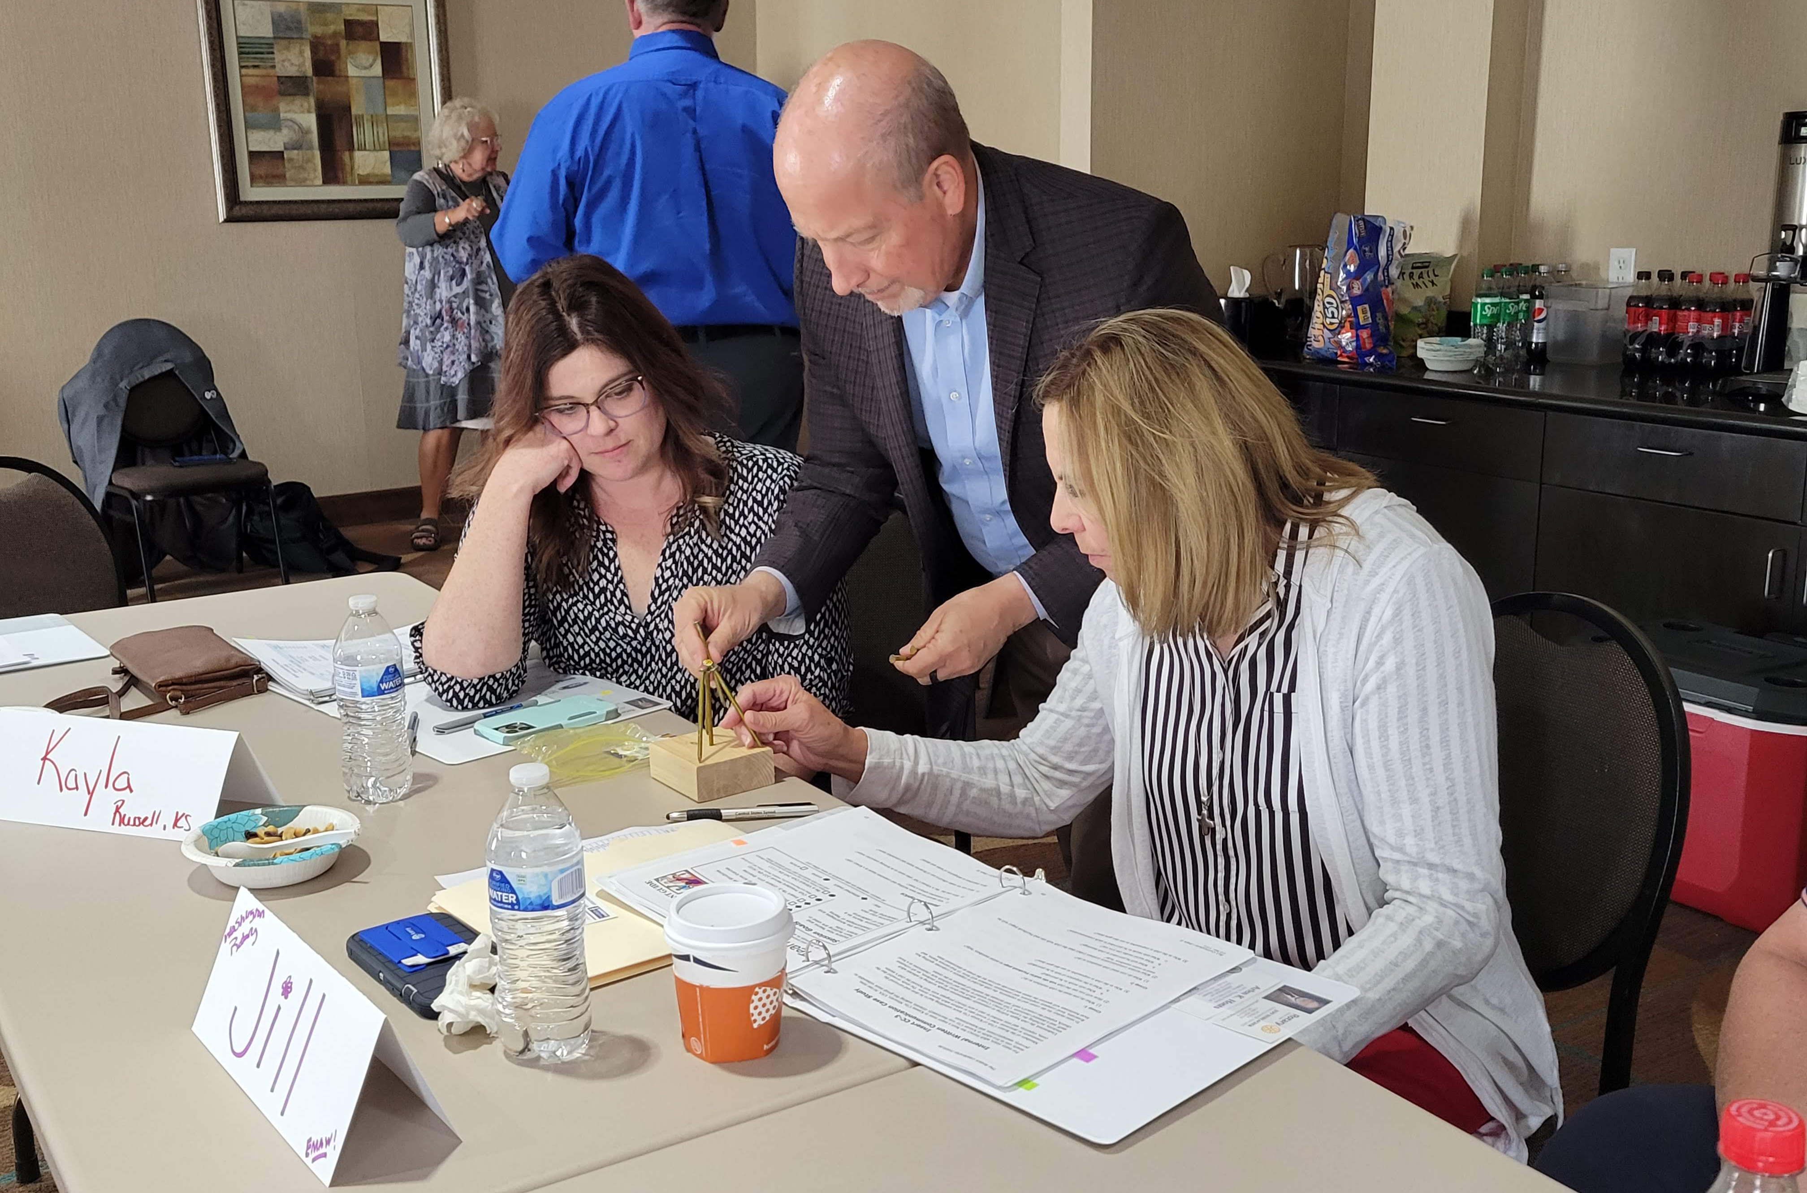
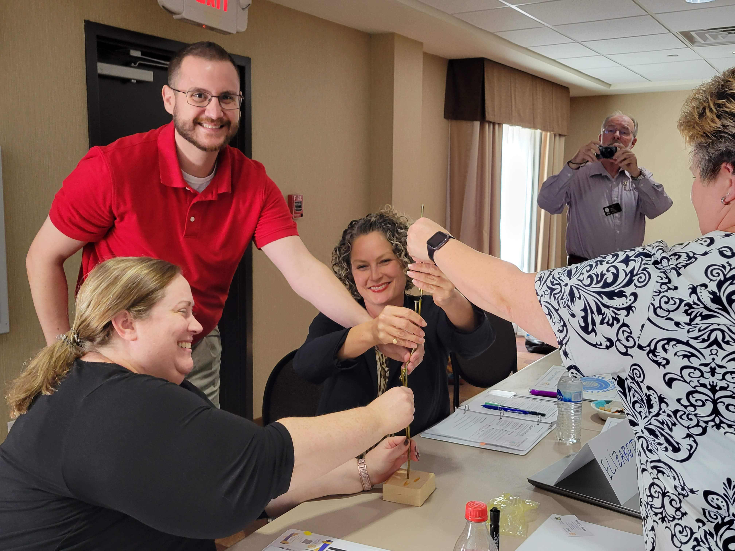
All Work & No Play Makes Jack….
Teamwork - Leadership Skills
Thinking Outside the Box… are all tested…..

Slide 8
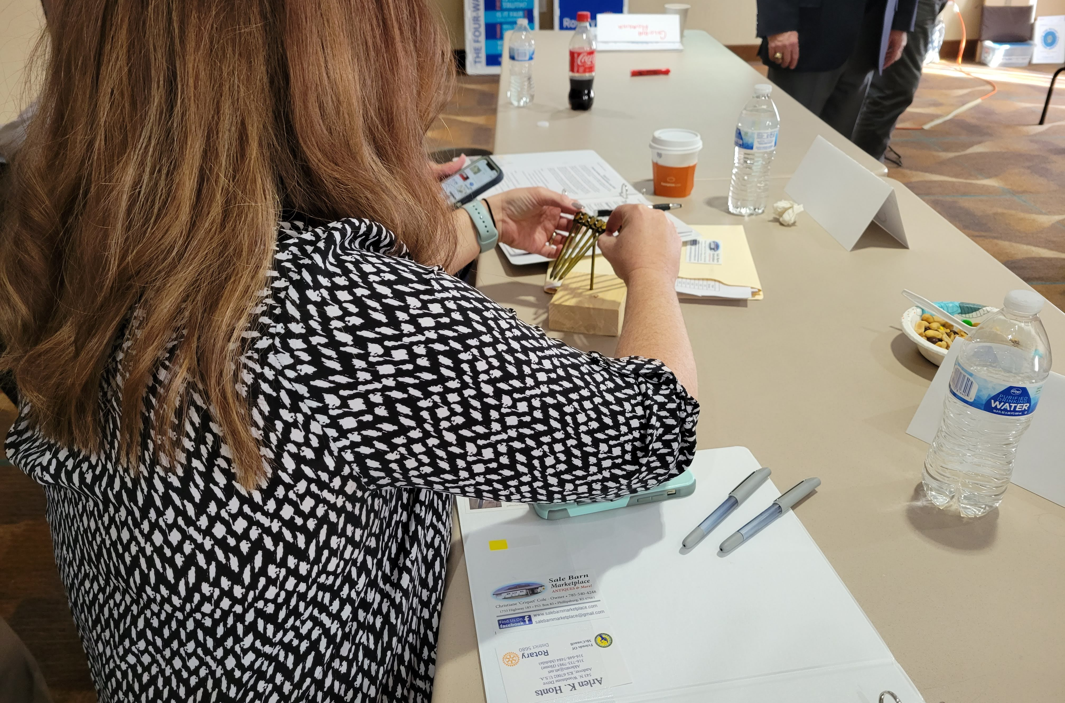
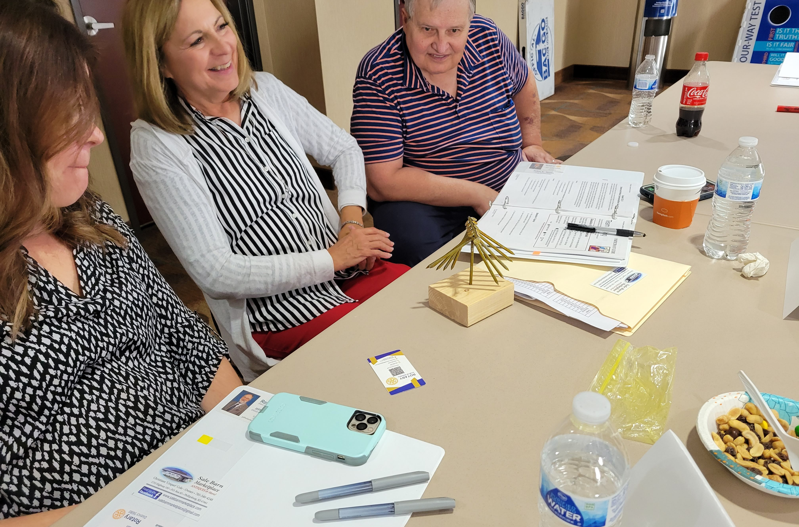
After much “trial & Error”……
Ta…Da…..!!!

Slide 9
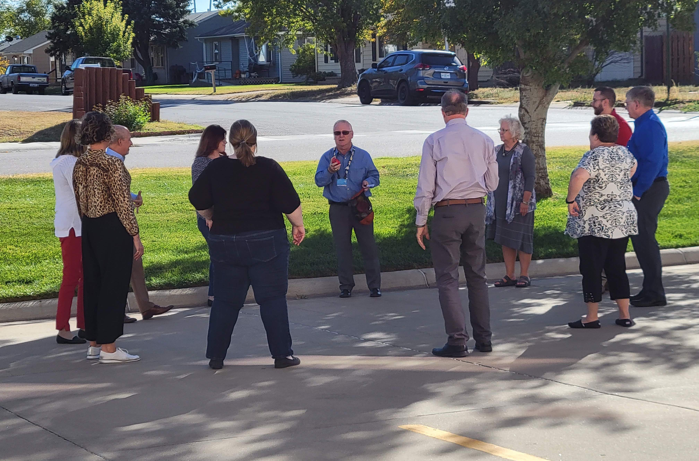
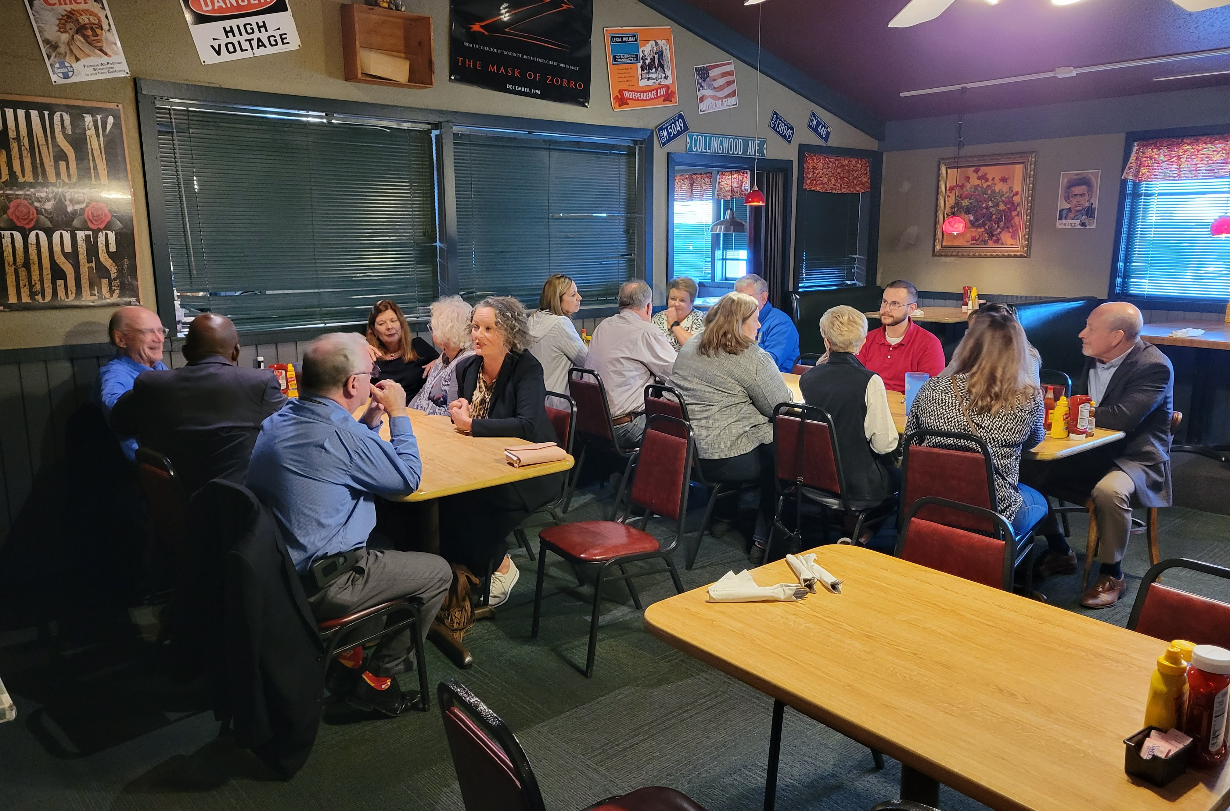
then, there was Recess & dining
@ Cattleman’s Cafe

